Slide 1
February 2021 Accessibility Program Managers Meeting
Moving Forward: Leaving No One Behind
Yvette Gibson | February 9, 2021
Notes:
SAMPLE COVER

Slide 2
Get Certified
Accessibility Program Managers Meeting
Samantha Evans, CAE, MBA | February 9, 2021
Notes:
SAMPLE COVER

Slide 3


IAAP, a division of G3ict
The mission of the International Association of Accessibility Professionals (IAAP), is to define, promote, improve, and diversify the accessibility profession globally through certification, education, and networking in order to enable the creation of accessible products, content, services, and environments.​

Slide 4
Building an Accessible Future
Professional Certifications:
Granted by an organization with a certification commission or committee
Not tied to a training course or educational program
Valid for a fixed period of time
Require ongoing professional development and education
Can be renewed
Establish standard expectations of skills or knowledge for roles and responsibilities
Provide a framework for shared understanding of concepts and standards
Improve consistent work processes within organizations
Offers credibility to the credential holder
Illustrate expectations of those in a profession, industry, or trade

Slide 5
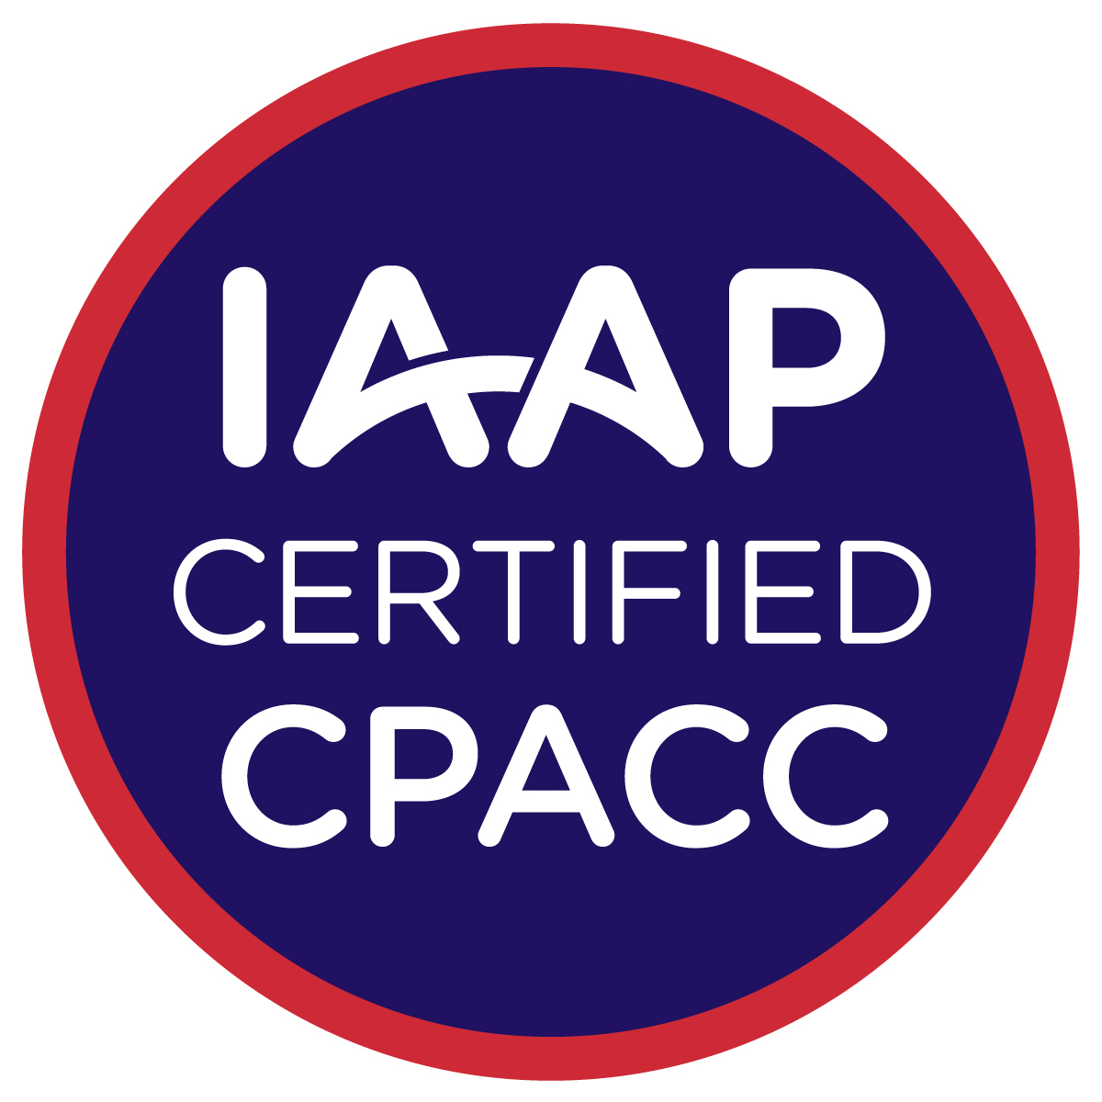

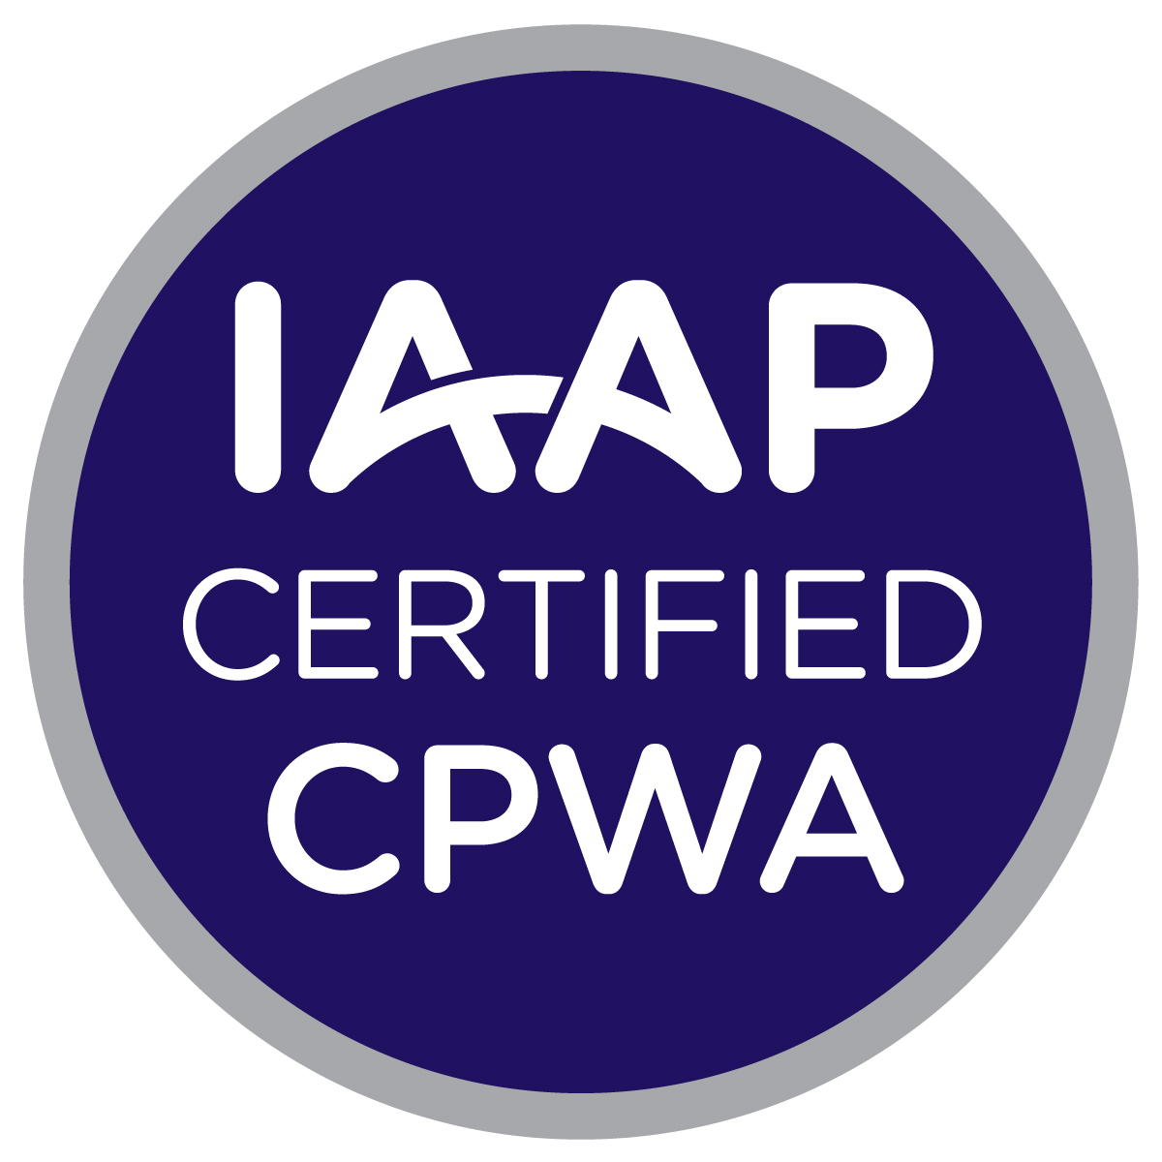
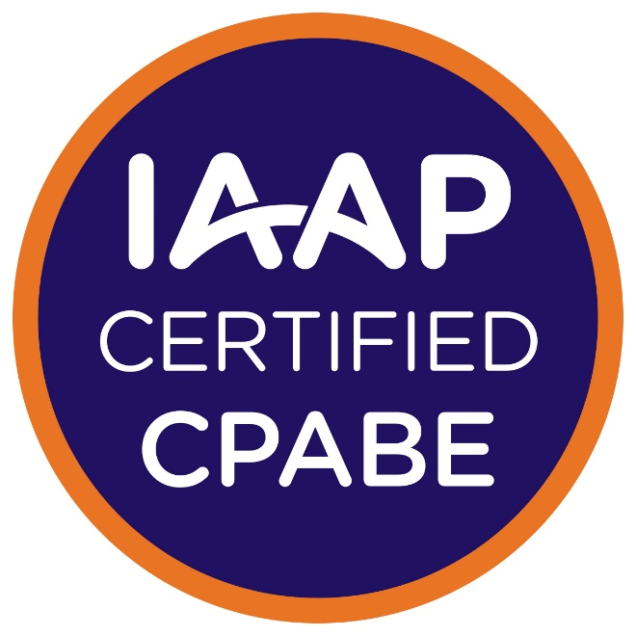

IAAP Certification Programs

Slide 6
Certified Professional in Accessibility Core Competencies
CPACCs help shape an accessible future with knowledge of:
Disabilities
Models of disabilities and their strengths and weaknesses
Adaptive strategies used by people with disabilities
Assistive technologies as accommodations
Universal Design & Universal Design for Learning
Tenants of web accessibility
Accessibility laws and regulations around the world
Advise on how to integrate accessibility into an organization

Slide 7
Web Accessibility Specialist (WAS)
WASs help shape an accessible future with knowledge of:
Creating accessible web solutions
WCAG 2.1 (WAI-ARIA, ATAG, Normative & Non-Normative)
Impact of accessibility for people that rely on web solutions
Identifying accessibility issues in web solutions
Accessibility and usability testing with assistive technologies
Limitations of automated testing solutions + value of manual testing in addition to automated testing as best practice
Remediating issues in web solutions
Level of severity & prioritization of issues
Recommended strategies to incorporate accessibility

Slide 8
Certified Professional in Web Accessibility (CPWA)
CPWAs shape an accessible future by:
Bringing a strong foundational knowledge of disabilities, adaptive strategies, and assistive technology
Complimenting essential components of Universal Design and Web Accessibility
Integrating intermediate technical web accessibility skills and accessibility core competencies
Enhance understanding with experience in accessibility and usability testing of web solutions
Can help advise teams integrate accessibility best practices in design, policy, and technical areas across organizations

Slide 9
Certified Professional in Accessible Built Environments (CPABE)
CPABEs help shape accessible future by:
Auditing built environments to include digital components of space and structures
Understanding and applying best practices in Universal Design including smart technologies
Implementing accessibility standards, codes and international legislation knowledge for specific space and building purposes
Present findings to built environment teams so they understand the relevance of accessibility to remove barriers for people

Slide 10
Accessible Document Specialist (ADS)
ADSs shape an accessible future by:
Creating accessible documents in authoring formats
Remediating documents in a variety of formats
Auditing and testing documents for accessibility
Understanding and explaining the limitations on automated document testing
Documenting accessibility training and planning
Establishing accessible workflows and best practices for electronic documents
Advising on policy and advocacy

Slide 11
Building an Accessible Future
Certified Accessibility Professionals are:
Providing guidance, advice, and services to remove barriers and making the world a more accessible place
Demonstrating commitment to the accessibility profession
Advancing the roles and responsibility of accessibility professionals by distinguishing unique skills and knowledge
Establishing benchmarks and standards for accessibility professionals and practitioners
Increasing awareness and recognition for the accessibility profession
Highlighting and distinguishing organizations’ integration of accessibility into your ethos

Slide 12
Questions?
Visit our main Certification Webpage for a guide to IAAP Certifications
https://www.accessibilityassociation.org/certification
Contact me by email
certification@accessibilityassociation.org
Join us for a Certification Drop-In Session on Wednesdays (9 am & 5 pm EST)
https://accessibilityassociation.formstack.com/forms/iaap_certification_dropin_sessions

